Slide 1
Applied Data Science
Team L – Scooby Data Doo
Final Presentation
Presenters - Rishab Narang and Karan Shah

Slide 2
Introduction, Motivation, & Goals
2008 market crash → Individuals could not pay back loans due to bad debt
Home Credit doesn’t want history to repeat and they have hired us to explore their data
Goals:
Accurately Predict home loan repayment for current customers
Expand scope: Build classifier that can help identify defaulters from new applicants
1

Slide 3
Data Description
9 csv files (Application_test.csv has no truth labels so not used):
Application_test.csv/Application_train.csv
Bureau.csv
Bureau_balance.csv
POS_CASH_balance.csv
Credit_Card_Balance.csv
Previous_Application.csv
Installment_Payments.csv
2

Slide 4
Data Preparation & Data Cleaning
Perform multiple joins, set differences, and intersections between all the files to obtain specified dataset of new customers
Categorical features that did not show variance among categories were dropped
Features with more than 70% missing were dropped
Final dataset
23000 rows & 112 features (13 are categorical & 99 numerical)
3

Slide 5
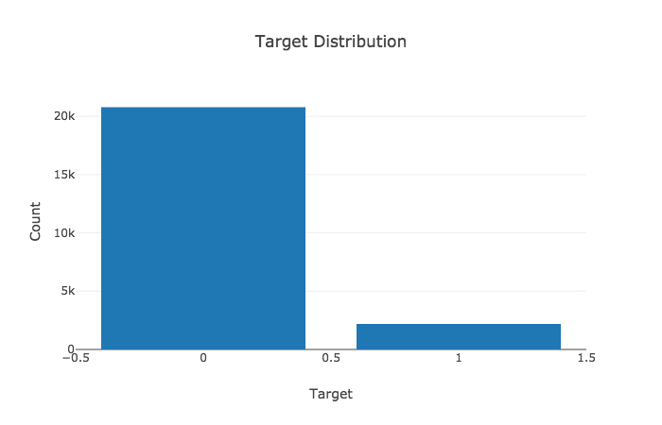
EDA
The underlying data has class imbalanced. 90.47%
of the applicants are not defaulters.
4

Slide 6
EDA
7

Slide 7
Methodology
Step 1: One Hot Encoding
Step 2: Train/Test Split
Step 3: Hyper Parameter Tuning using Cross Validation
Step 4: Pass Models (Logistic Regression, Knn, Naive Bayes, and Random Forest) with the optimal parameter from Step 3 to a Cross Validation Class to perform model fitting and prediction
Step 5: Pass the results from Step 4 to a metrics calculation function.
Step 6: Repeat Steps 4 and 5 three times
Before fixing class imbalance or performing feature engineering
After fixing class imbalance but not performing feature engineering
After fixing class imbalance and performing feature engineering
8

Slide 8
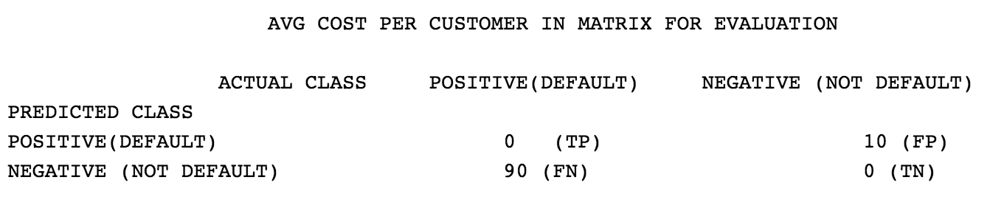
COST: Metric for Evaluation
Idea: For a manager at Home Credit, we want an easier metric for evaluating the best model.
Total Cost = C(FN) * no. of FN + C(FP) * no of FP
Goal: To choose the model with lowest total cost (minimize false negatives while ensuring opportunities are not lost)
Finding the right balance between opportunity cost and cost of accepting a potential defaulter.
9

Slide 9
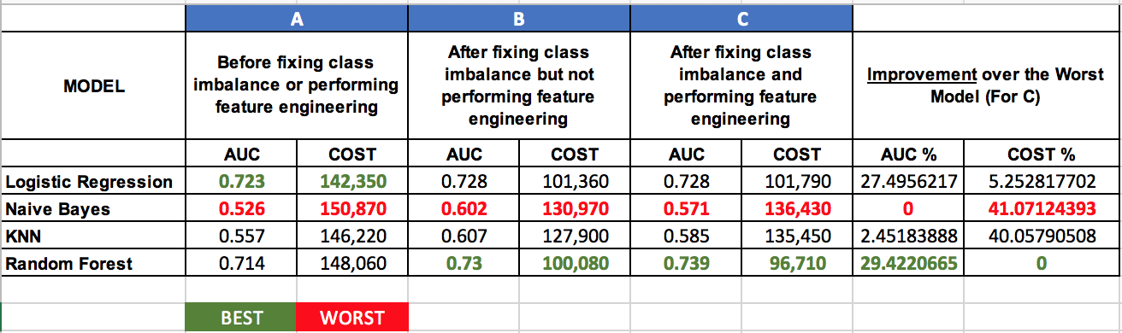
Model Comparison
The best model here is Random Forest (column C) because the AUC for the model is the best and the cost is also minimum. The right column shows improvement of AUC and COST from the worst models.
10

Slide 10
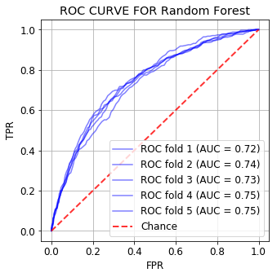
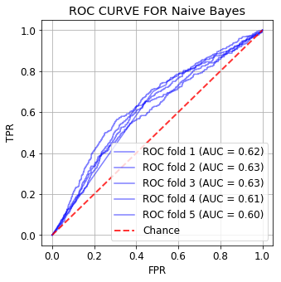
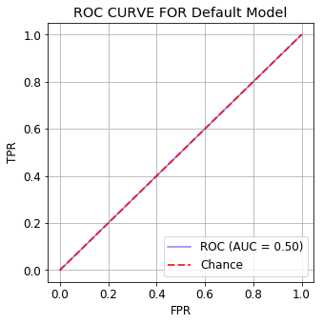
ROC CURVES
11

Slide 11
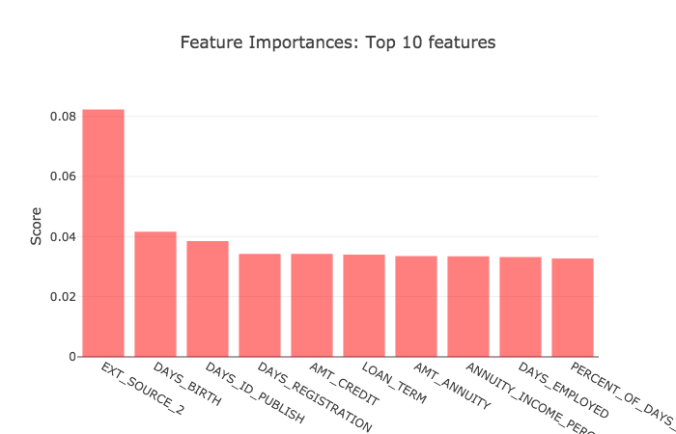
Final Model Results
12

Slide 12
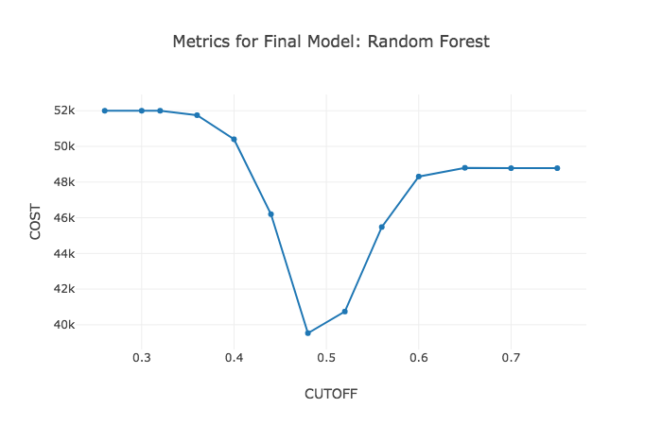
Final Model Results
13

Slide 13
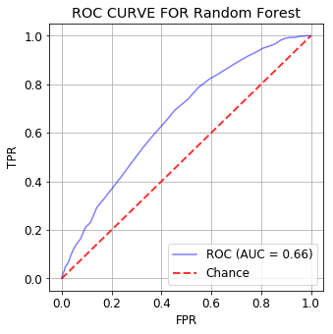
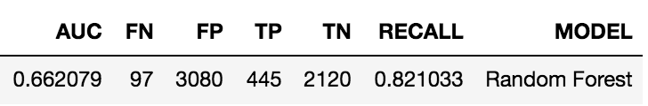
Final Model Results
14

Slide 14
Business Implications
Information gain from our assessment allows Home Credit to better evaluate new applicants (customers with 0 or 1 loan).
Shift Utility Function of Home Credit from Risk Averse towards Risk Neutral
Customer Base would increase.
15

Slide 15
Recommendations for Continuation Work
Macroeconomic factors
Application
Cost Metrics
LTV Value and Time Series Analysis
Clustering Information
Dataset Balancing Techniques
16

